Slide 1
Herpes Virus
By Mamita Rai Gurung

Slide 2
HSV is one of the best known virus with the frequency of infection and its propensity to cause recurrent ulcers in areas of the skin and mucous membranes.
Two types differ in their predilection for causing lesions “above the waist” (HSV-1) or “below the waist” (HSV-2).
Herpes virus is the DNA virus , Icosahedral 120–150 nm, envelop

Slide 3
EPIDEMIOLOGY
Herpes simplex viruses are distributed worldwide.
There are no known animal vectors, and humans appear to be the only natural reservoir.
Direct contact with infected secretions is the principal mode of spread.

Slide 4
Human herpes viruses (HHV)
Types | Diseases caused | Transmission
HHV-1 (herpes simplex virus 1) | eye infections, encephalitis | Cold sores, oral and Saliva skin contact
HHV-2 (herpes simplex virus 2) | Genital herpes, neonatal infection | Sexual, mother to child
HHV-3 (varicella zoster virus) | Chickenpox, shingles | Respiratory droplets, reactivation
HHV-4 (Epstein-Barr Virus | Glandular fever | Oral, saliva

Slide 5
Types | Disease | Transmission
HHV-5 (Cytomegalovirus | Glandular fever, congenital infection, disseminated infection in AIDS and immunocompromised, pneumonitis and hepatitis | Body fluids, transplacental
HHV-6 | Roseola infantum, mononucleosis | Primary and reactivation
HHV-8 virus | Associated with Kaposi’s sarcoma | Unknown
Notes:
Kaposi sarcoma (KS) is a cancer that develops from the cells that line lymph or blood vessels
Roseola infantum is a common, mild, viral infection that can cause a temperature andrash in babies and young children.

Slide 6
Infection caused by Herpes Virus
PATHOGENESIS:
Acute Infections
Pathologic changes during acute infections consist of development of multinucleated giant cells, ballooning degeneration of epithelial cells, focal necrosis, eosinophilic intranuclear inclusion bodies, and an inflammatory response characterized by an initial polymorphonuclear neutrophil (PMN) infiltrate and a subsequent mononuclear cell infiltrate.
The virus can spread intra- or interneuronally or through supporting cellular networks of an axon or nerve, resulting in latent infection of sensory and autonomic nerve ganglia. Spread of virus can occur by cell-to-cell transfer and can therefore be unaffected by circulating immune globulin

Slide 7
Latent Infection: HSV-1 may become latent within sensory nerve root ganglia of the trigeminal nerve. Latent infection of nervous tissue by HSV does not result in the death of the cell; however, the exact mechanism of viral genome interaction with the cell is incompletely understood. Several copies of the HSV viral genomes are in each latently infected neuronal cell.
Reactivation of virus from latently infected ganglionic cells with subsequent release of infectious virions appears.
The factors that are known to initiate reactivation of herpes simplex include; exposure to ultraviolet light, fever and trauma.

Slide 8
MANIFESTATIONS
Herpes Simplex Type 1:
Infection with HSV-1 is usually “above the waist.” It consists characteristically of grouped or single vesicular lesions that become pustular to form single or multiple ulcers. On a dry surfaces nails, fore fingers. Ectoderm (skin, mouth, conjunctiva, nervous system)
Primary infection with HSV-1 is often asymptomatic. When symptomatic, typically in children, it appears most frequently as gingivostomatitis, with fever and ulcerative lesions involving the buccal mucosa, tongue, gums, and pharynx. The lesions are quite painful, and the acute illness usually lasts 5 to 12 days. After this initial infection,
Notes:
gingivostomatitis or orolabial herpes) is a combination of gingivitis and stomatitis, or an inflammation of the oral mucosa and gingiva.

Slide 9
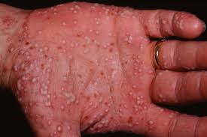
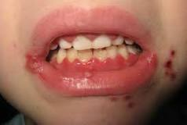
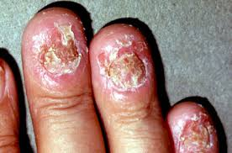

Slide 10
Herpes simplex virus sometimes infects the finger or nail area. This infection, termed herpetic whitlow, usually results from the inoculation of infected secretions through a small cut in the skin. Painful vesicular lesions develop in the finger; they are often mistaken for bacterial infection and mistreated accordingly.
Herpes simplex virus infection of the eye is one of the most common causes of corneal damage and blindness in the developed world. Infections usually involve the conjunctiva and cornea, and characteristic dendritic ulcerations are produced.
Encephalitis may rarely result from HSV-1 infection. Most cases occur in adults.

Slide 11
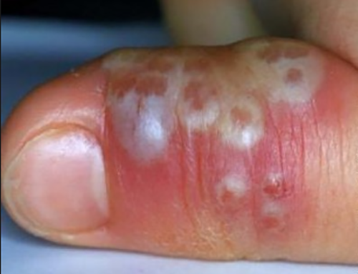
herpetic whitlow

Slide 12
Herpes Simplex Type 2
Primary Genital Herpes Infection: sexually transmitted infections. Small erythematous papules leison begins that soon form vesicles and then pustules. Within 3 to 5 days, the vesiculopustular lesions break to form painful coalesced ulcers.
Recurrent Genital Herpes Infection: In contrast to primary infection, recurrent genital herpes is a disease of shorter duration, usually localized in the genital region, and without systemic symptoms. A common symptom is appearance of lesions in the genital area.

Slide 13
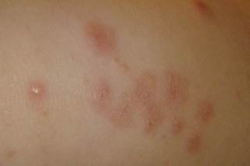
erythematous papules leison

Slide 14
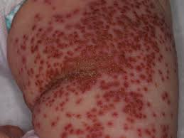
vesiculopustular lesions

Slide 15
3. Neonatal Herpes: Neonatal herpes usually results from transmission of virus during delivery through infected genital secretions from the mother.
Manifestation vary. Some infants show disseminated vesicular lesions with a widespread internal organ involvement and necrosis of the liver and adrenal glands, and others have involvement of the central nervous system only, with listlessness and seizures.
Notes:
This abnormal and intense wave of electricity overwhelms the brain and results in a seizure, which can cause muscle spasms, a loss of consciousness, strange behavior, or other symptom
Listlessness:- Lacking energy or disinclined to exert effort

Slide 16
Laboratory diagnosis
Specimen:- vesicular fluid, corneal scrapping:-
Microscopy
Direct virus detection (Cytopathology)
Tzanck smear:- stain the scrapings obtained from vesicles, 1% aqueous solution of toluidine blue O, shows multinucleated gaint cells.
Giemsa stain:- intranuclear cowdry type A
inclusion bodies
Notes:
Cowdry bodies are eosinophilic or basophilic nuclear inclusions composed of nucleic acid and protein seen in cells infected with Herpes simplex virus, Varicella-zoster virus, and Cytomegalovirus. They are named after Edmund Cowdry

Slide 17
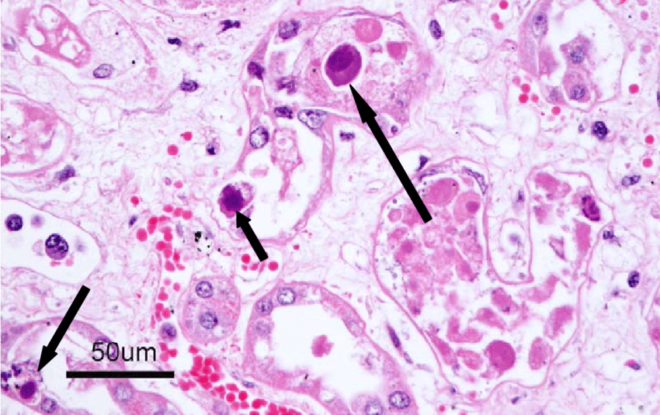

Slide 18
Isolation and identification of virus:-
Virus may be isolated from hepartic leison and may found in CSF, throat swabings, stool during primary infections and asymptomatic period by cell culture, and identified by fluorescent antibody staining.

Slide 19
3.Polymerase chain reaction: Viral DNA detection by amplification of viral DNA from CSF.
4. Serology:- Antibodies appear in 4-7 days after infection and reach peak in 2-4 weeks. The use of HSV type specific antibodies against antigen in serum by ELIZA, complement fixation test or nuetralization test.

